Slide 1
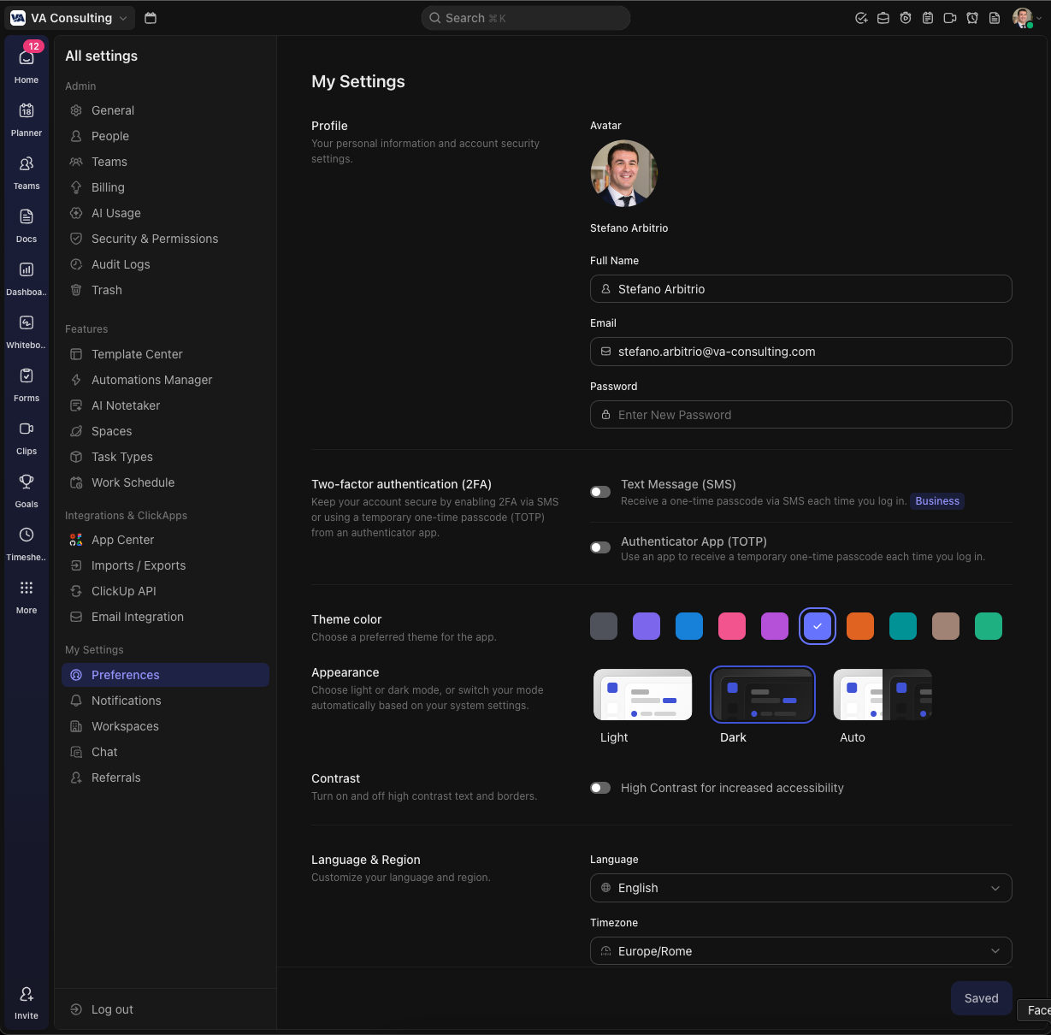

Slide 2
Beyond the visual aspect, what is fundamentally important is that the super admin must be able to modify the fields within the registration sections and/or add new stages with additional sections.
Another important note: in the Turnover & Clients section, the years must update automatically. We require a five-year historical view; therefore, in 2026 we would request 2025, 2024, 2023, 2022, 2021. In 2027, we would request 2026, 2025, 2024, 2023, 2022, and so on. This must update automatically.
Additional relevant technical aspects:
When a user completes the registration process, the profile must undergo our review before being published. Final approval and publication must be granted by us.
Users must not be allowed to register with personal email addresses. A restriction should be implemented to accept only corporate domains.

Slide 3
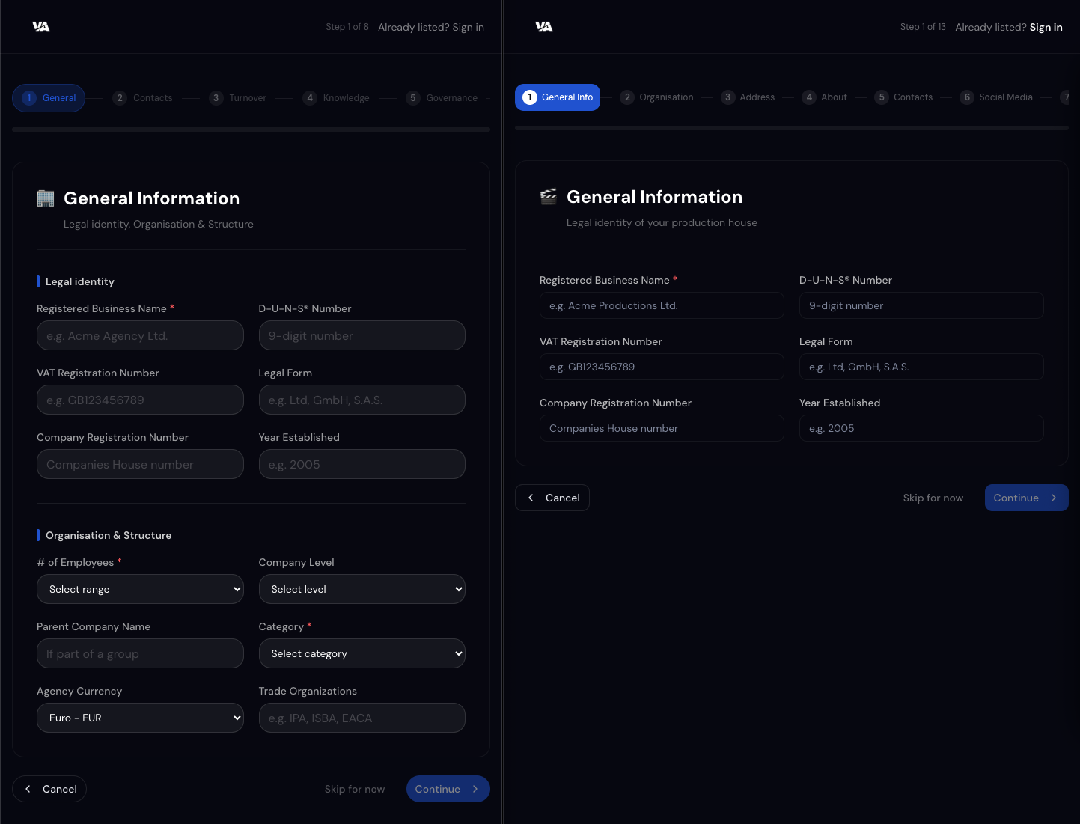
PLEASE STANDARDISE THE SAME LAYOUT FOR BOTH REGISTRATION FORMS USING THE AGENCY ONE
Remove all emoticons we must keep a corporate layout and look&feel
Please use infos
From list menu in
RFI

Slide 4
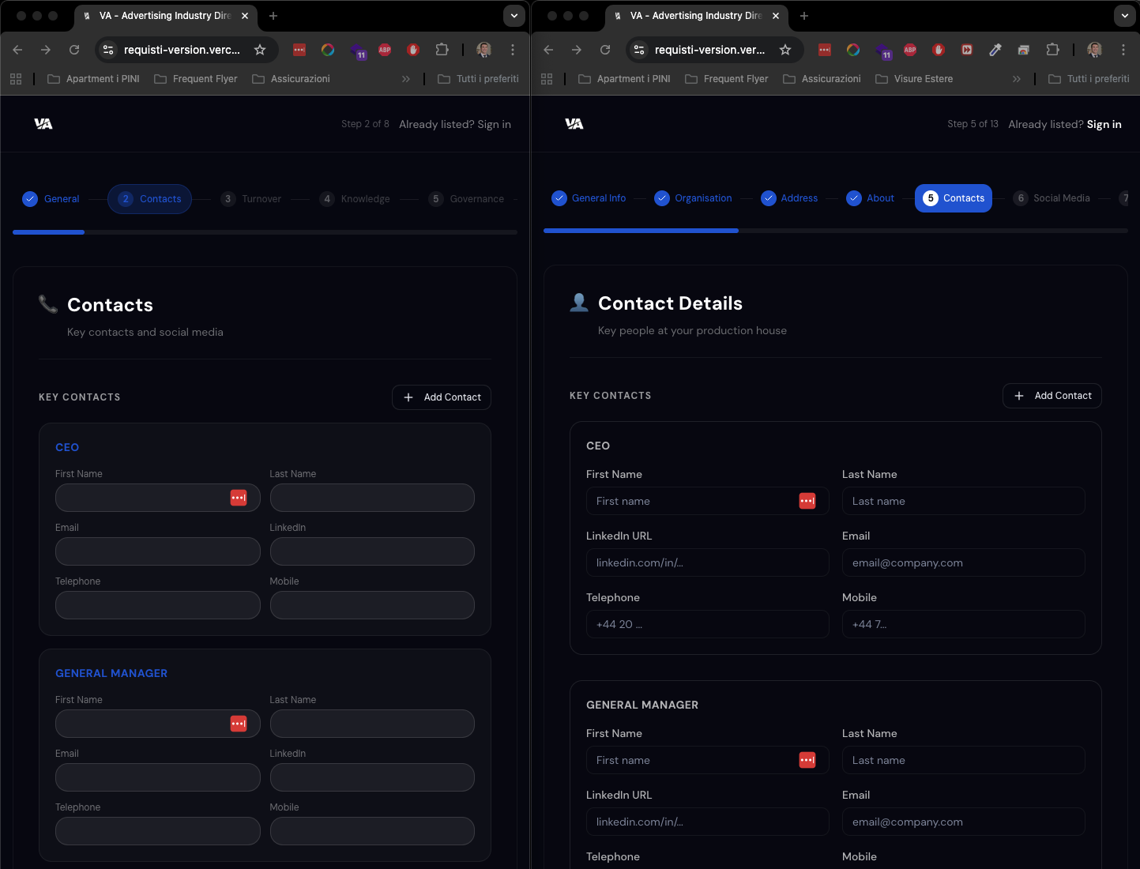
PLEASE STANDARDISE THE SAME LAYOUT FOR BOTH REGISTRATION FORMS USING THE AGENCY ONE

Slide 5
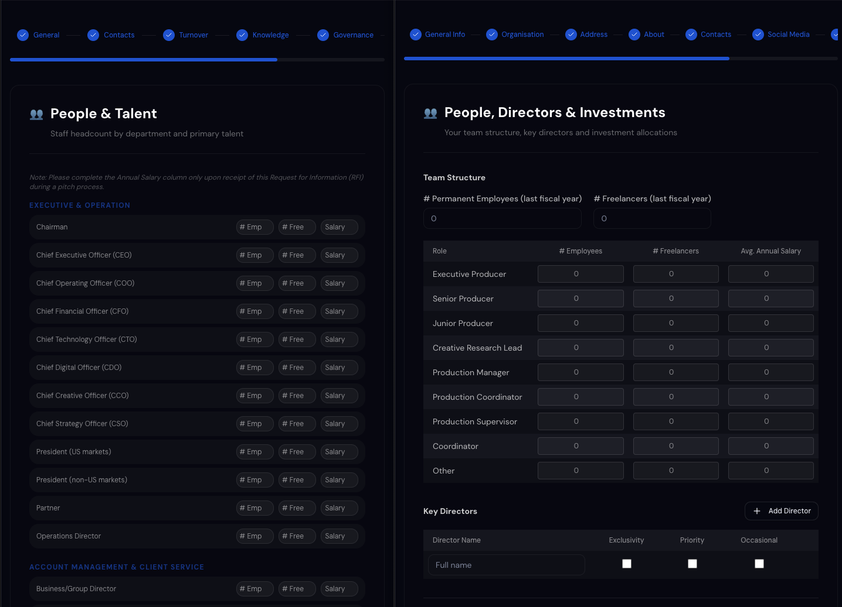
PLEASE STANDARDISE THE SAME LAYOUT FOR BOTH REGISTRATION FORMS USING THE AGENCY ONE
Please use agency look&feel but with the same size of production cells. Here the currency is already set up from step 1 Organization & Structure -> Agency Currency
Too small
Good size and space

Slide 6
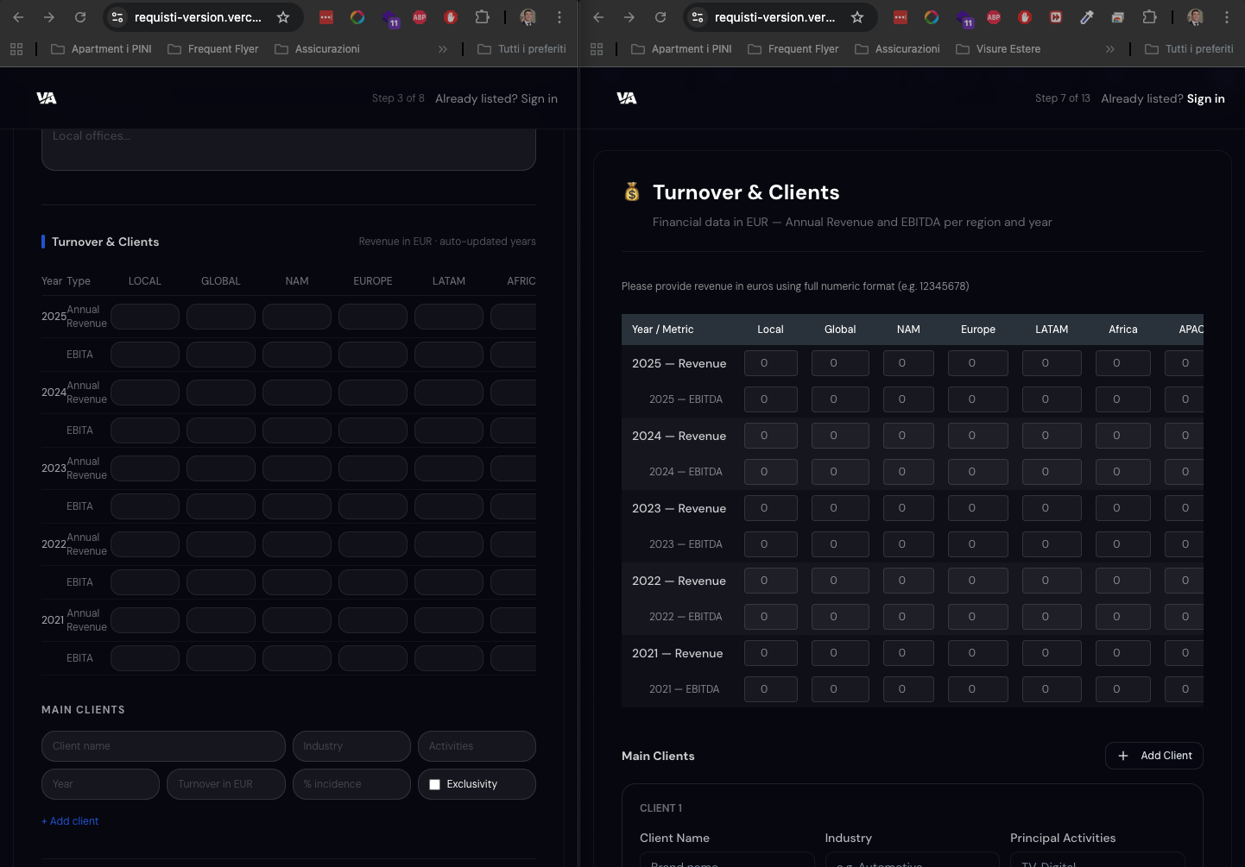
PLEASE STANDARDISE THE SAME LAYOUT FOR BOTH REGISTRATION FORMS USING THE AGENCY ONE
Please allow currency set up per
Each column

Slide 7
PLEASE STANDARDISE THE SAME LAYOUT FOR BOTH REGISTRATION FORMS USING THE AGENCY ONE
For all other steps ☺ i guess you dont need all screenshot!

Slide 8
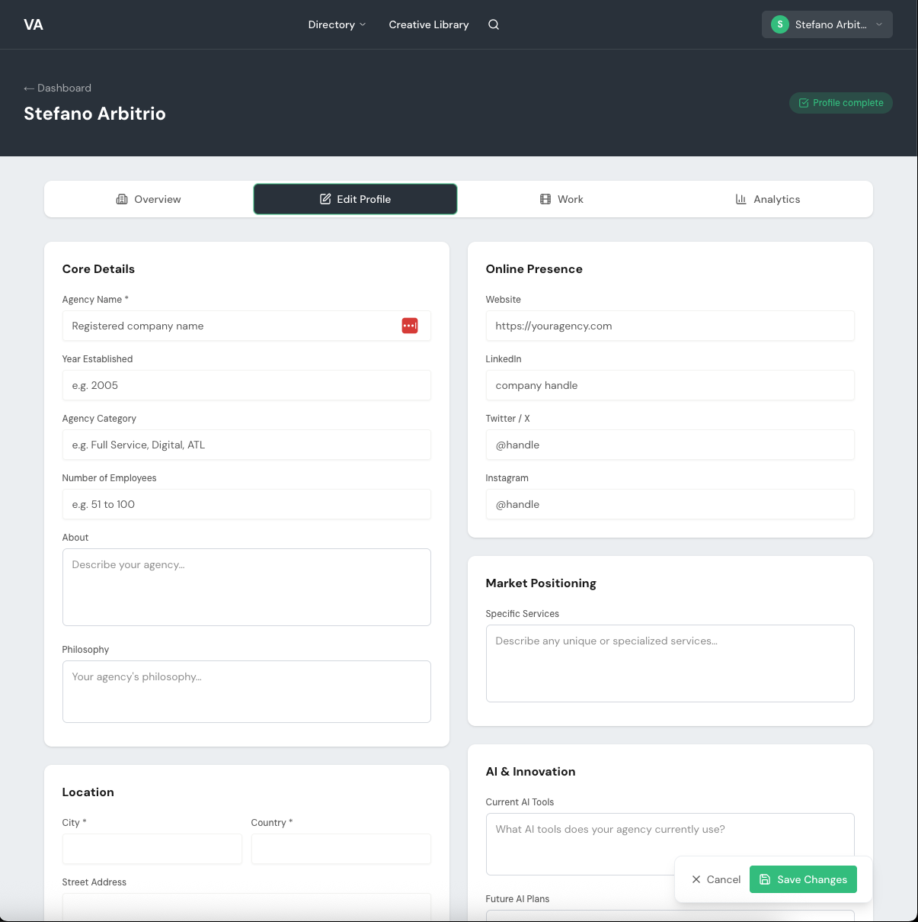
An important technical note: not all fields should be editable independently by the user.
By when do I need to provide you with feedback on which fields can be modified autonomously and which should require our prior approval?

Slide 9

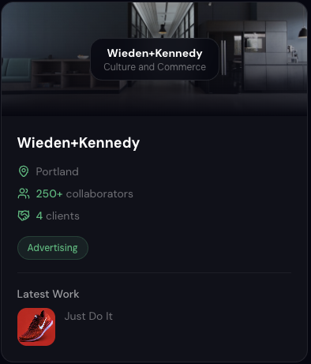
Is not possible to upload the logo and test how it works
Current
From VTSCAN
I assume the logo will be placed here, using the same format as Scanbook.
Logo and cover must have same dimension
Not yet follow next page

Slide 10
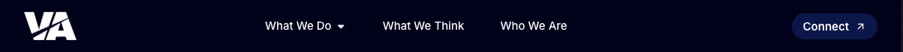
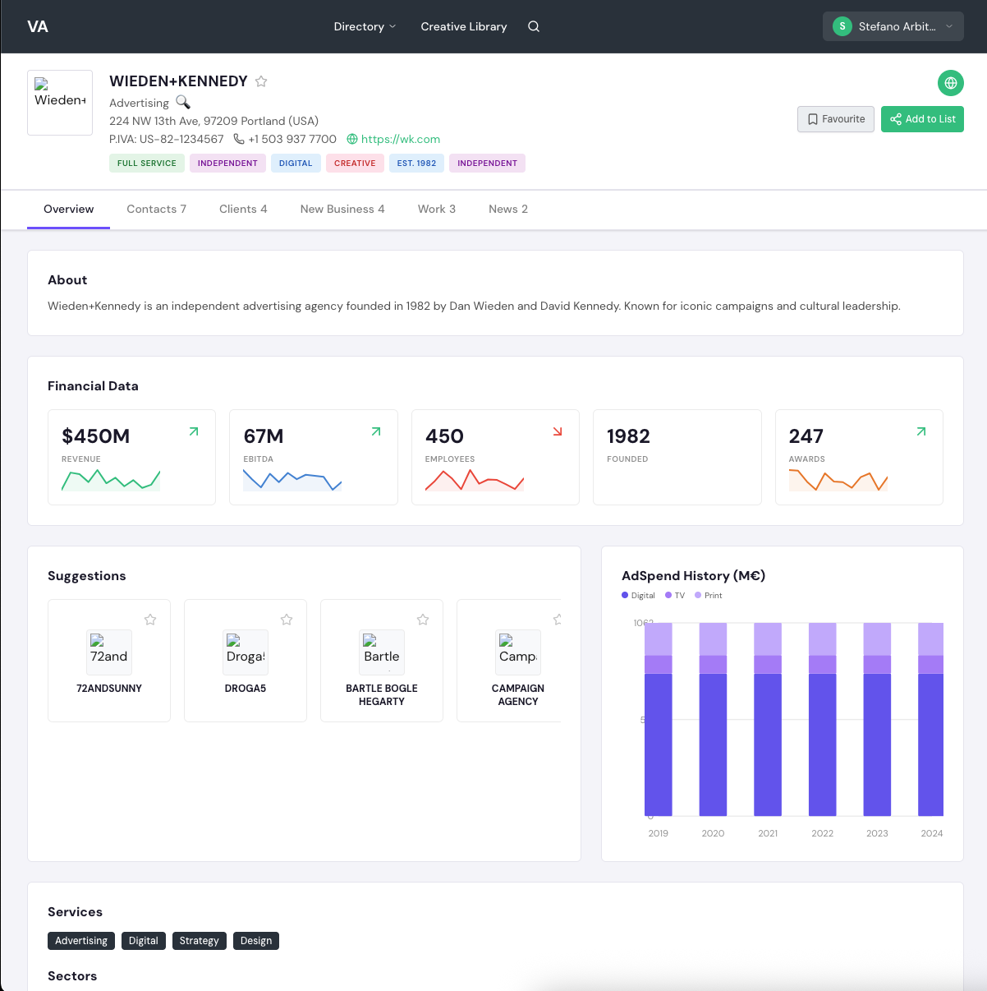
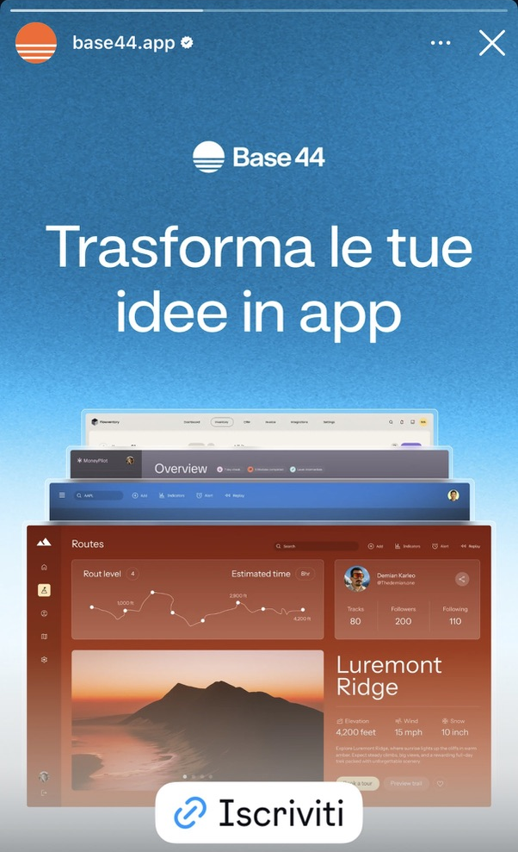
Aura
Remove and keep the same background color
Ok but only if user has log in. Only the user (Client) can have a favourite list
Increase the size of the logo
Consider a cover image
Remove
As tab use the 8 steps of the registration form
Use website background
Fancy but not enough.
We should also consider that we will be positioning and selling the platform partly on its aesthetic appeal, particularly in terms of how it showcases agency profiles.
It is therefore essential that the pages adopt a refined, futuristic dark look and feel, in line with the example I am sharing with you.
Not all these numbers need a graphic for some of those an icon its enough

Slide 11
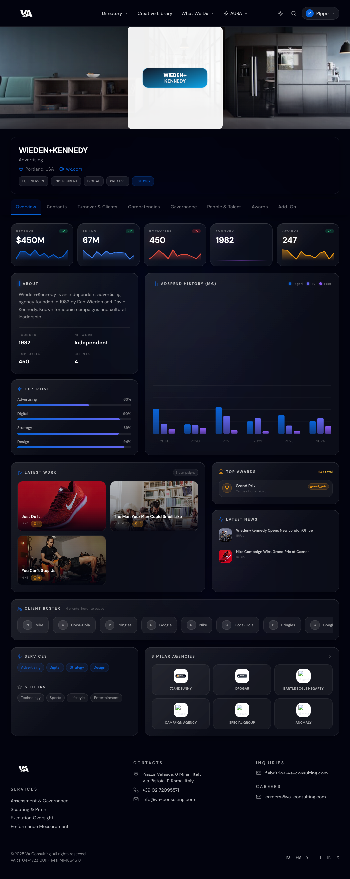
Not all these numbers need a graphic. People need an icon
Founded need an icon
Award need an icon
Fancy but not enough.
We should also consider that we will be positioning and selling the platform partly on its aesthetic appeal, particularly in terms of how it showcases agency profiles.
It is therefore essential that the pages adopt a refined, futuristic dark look and feel, in line with the example I am sharing with you.
Theese graphs ar not rapresenting relevant things
I like it but from where they can select or add clients the can/want to show?

Slide 12
Important things that we are missing on this moke up:
Anyone by using company domain can create an account
Once you have create your own account you must classify your own account: vendor or client
If you are a vendor you can add on your panel your agency, your production company or both
If you are a vendor you can see and manage just your companies, you cannot see other infos regarding registered competitors
If you are a client you cannot register companies, on a free version you can see just restricted infos, if you pay you can have access on more layers of infos.

